Slide 1
Introducing Python Collections
Lesson 4

Slide 2
Objectives
To understand Python lists
To use lists as a means of storing data
To use dictionaries to store associative data
To implement algorithms to compute elementary statistics

Slide 3
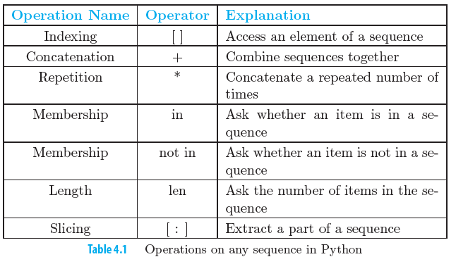
List operations

Slide 4
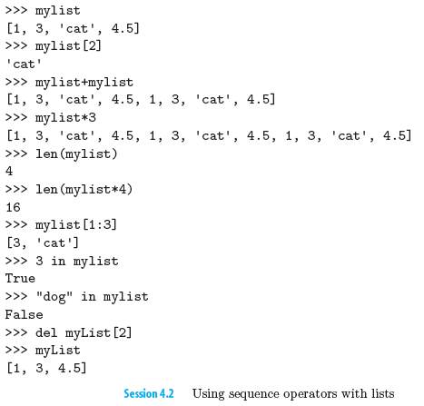

Slide 5
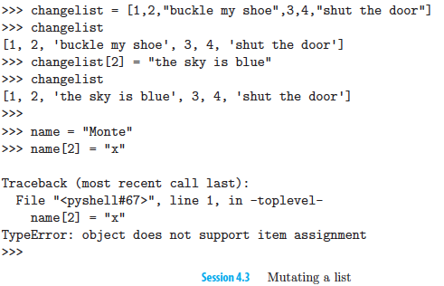
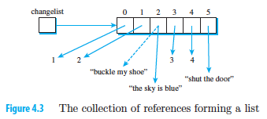
Mutable List

Slide 6
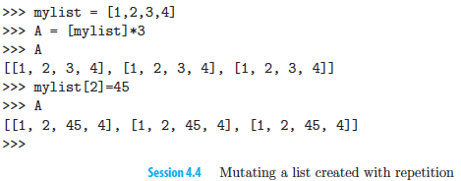
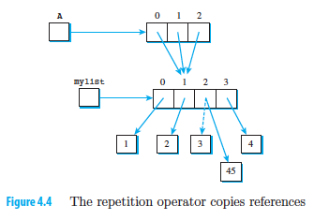
Repetition operator on list

Slide 7
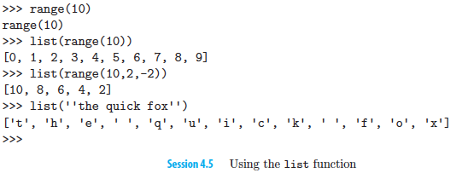
List function

Slide 8
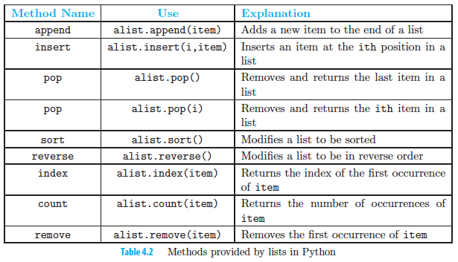
List function

Slide 9
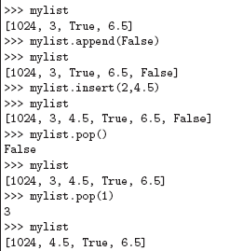
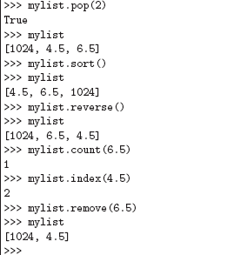
Examples of list method

Slide 10
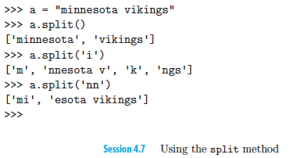
Split method

Slide 11
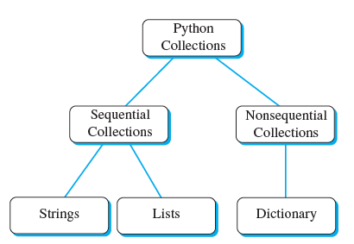
Dictionary
Unordered, associative collection is called a dictionary.
Python dictionaries are collections of associated pairs of items where each pair consists of a key and a value.

Slide 12
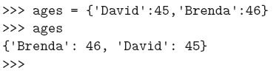
Dictionary
key-value pair is written askey:value.
Dictionaries are written as comma-delimited key:value pairs enclosed in curly braces.
The empty dictionary is written as {}.

Slide 13
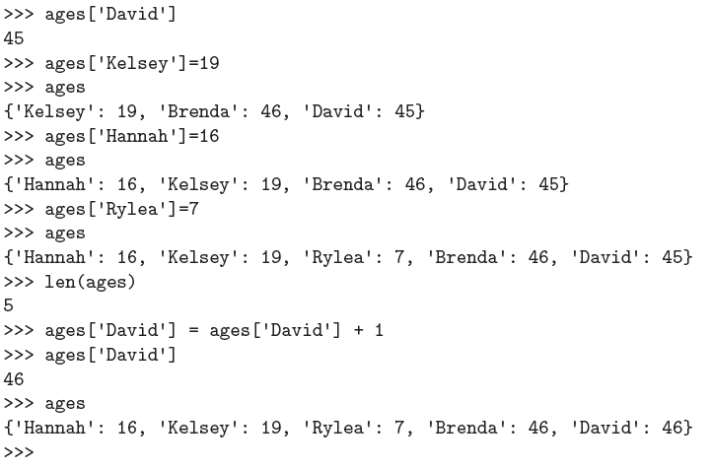
Using dictionary

Slide 14
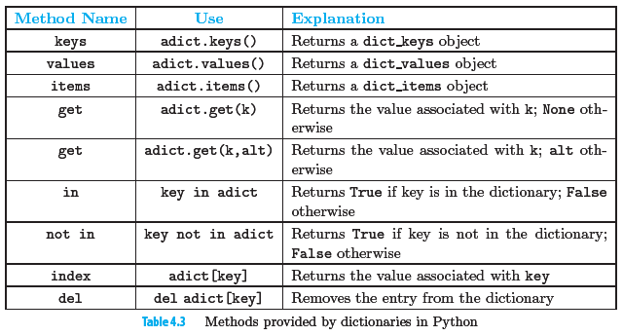
Dictionary Methods

Slide 15
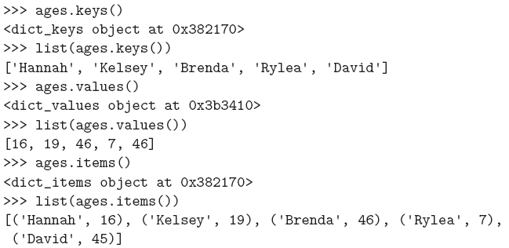
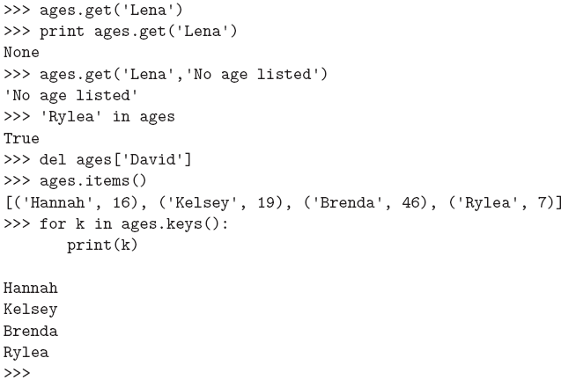
Dictionary Methods
These pairs are stored as tuples. Tuples are verysimilar to lists in that they are heterogeneous sequences of data. The difference is that a tuple is immutable. Like a string, a tuple element cannot be changed.
Tuples are written as comma-delimited values enclosed in parentheses. As sequences, they can use any of the operations that were described earlier for lists and strings.
Notes:
Stop here … 2 Feb 2016

Slide 16
Working with CSV Files
https://automatetheboringstuff.com/chapter14/

